Slide 1






Slide 2
A handcrafted evolving map
Notes:
OpenStreetMap is a handcrafted, evolving map
At first, the changes are very visible, like the work we're doing today.
But as the map evolves, more and more small details get added.

Slide 3
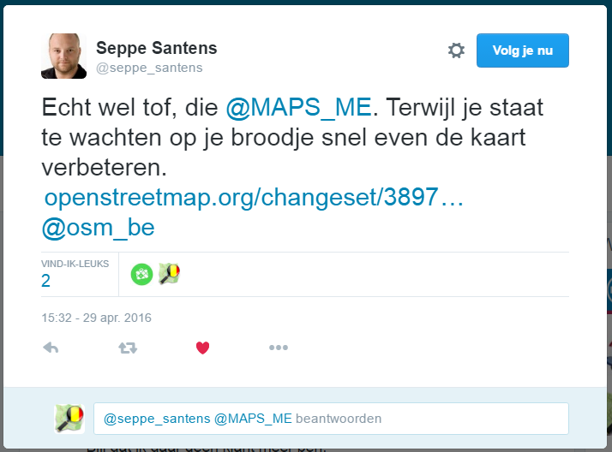
Notes:
A new mapper might start adding the opening hours to the places they use.

Slide 4
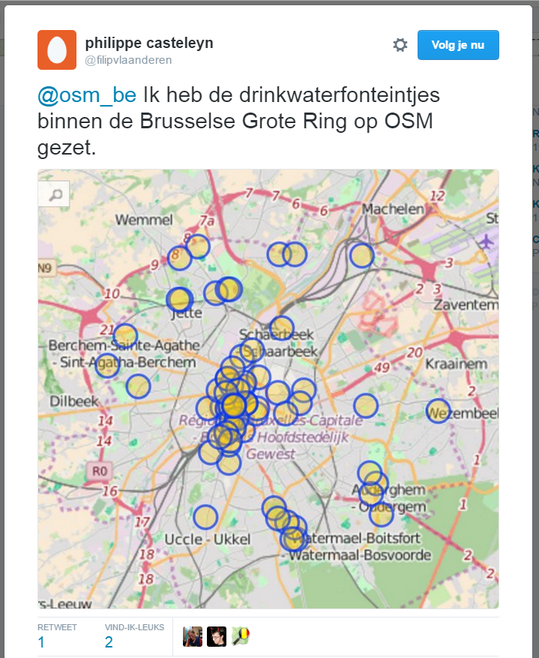
Notes:
Or get a bit more ambitious and map ALL the water fountains in Brussels.

Slide 5
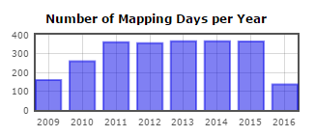
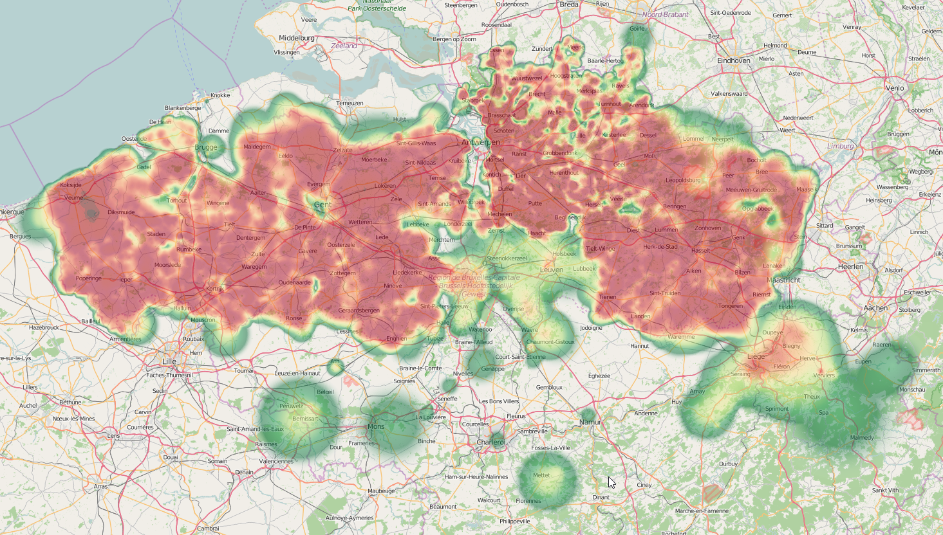
Notes:
And some of us go a little crazy and map ALL DAY EVERY DAY until every little spot in their region has all landuse mapped

Slide 6
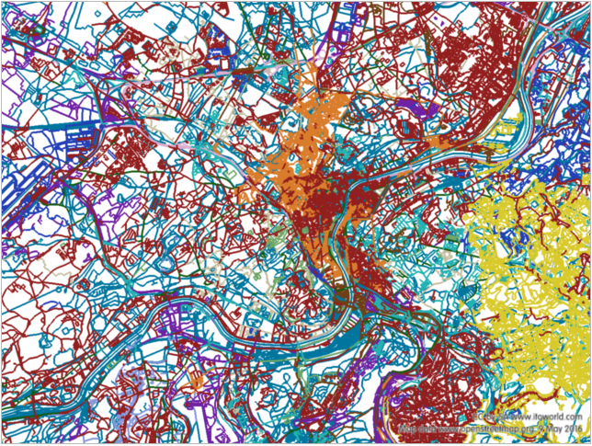
Notes:
Put all this together, and you get a map reflecting the colours of many different people.

Slide 7
What’s in it for me?
Notes:
Because we can map what you need, together.

Slide 8
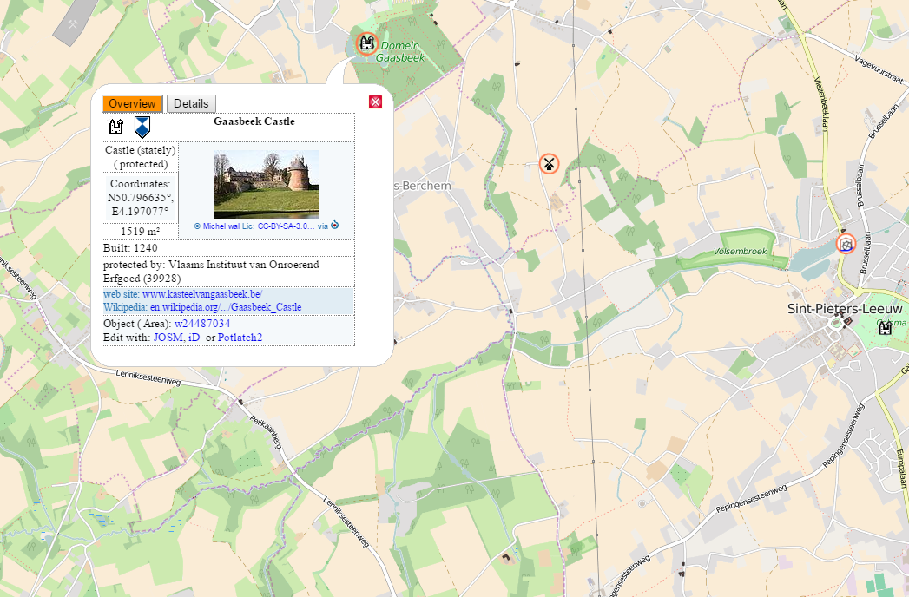
Notes:
Don't forget, you're not doing this for any single website.
If you add a castle, it also shows up on the historical place map. Someone might come along to add all kinds of extra information, maybe even a picture.

Slide 9
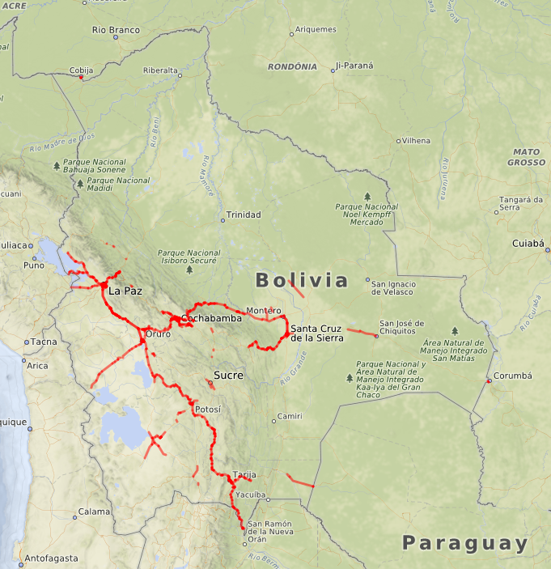
Notes:
With the help of twitter, the map of the Bolivian asphalted roads went from this …

Slide 10
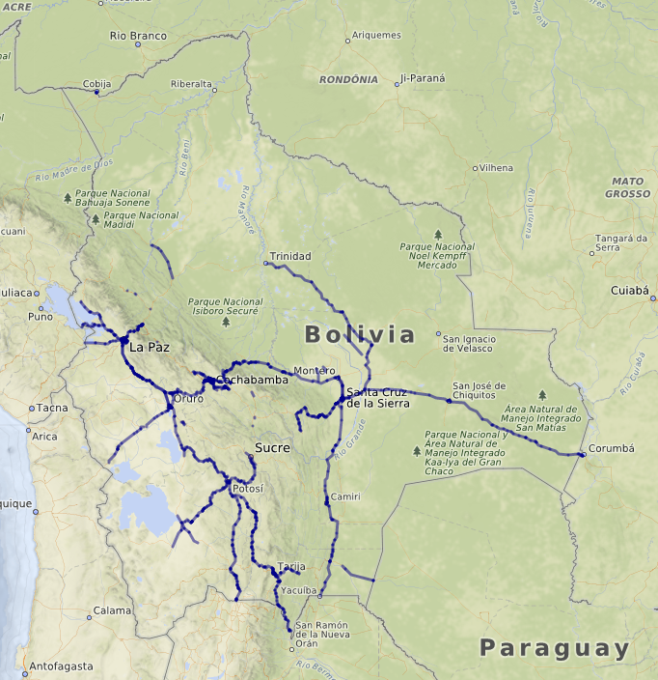
Notes:
to this in just three days. There simply is no other global dataset containing this much road quality data. And it is still easy to make it much much better.

Slide 11
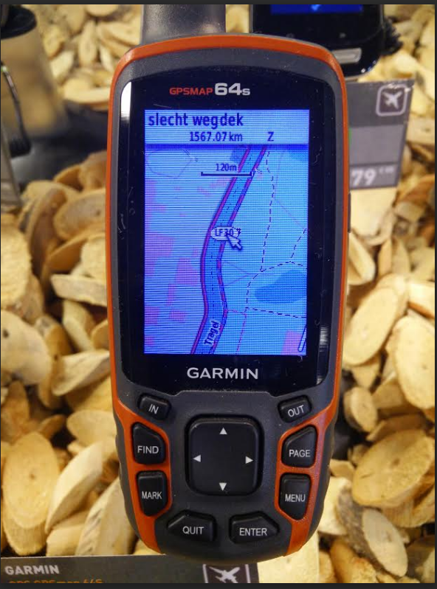
Notes:
And it isn't just some nerds playground. Most Garmin GPS units come pre-loaded with OSM maps now. Like this bicycle unit, which warns you of the bad road ahead.

Slide 12
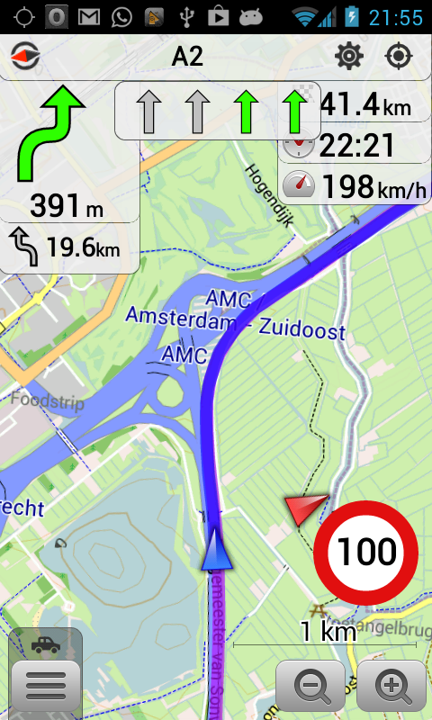
Notes:
The tools are there, and they are all open source. With OSMAND, you download all the data you need when you have good wifi. Then you hit the road with a car-centered map, or one which shows dog asylums and bicycle parkins, or your own map style which focusses on your own interests. And add some of your own data too if you want to.

Slide 13
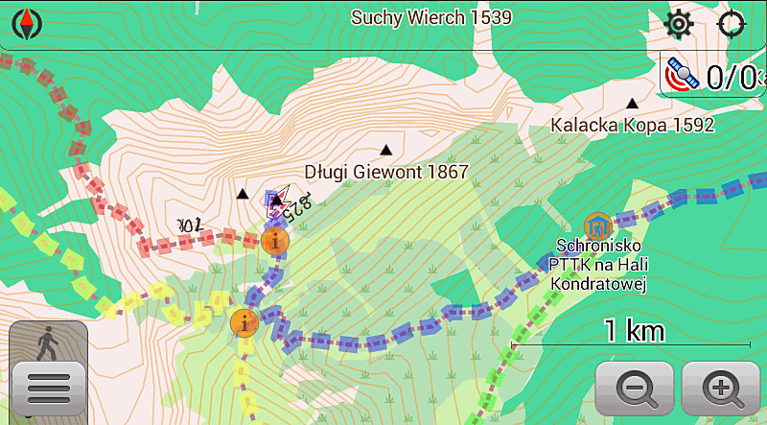

Slide 14
How could this ever work?
Just you, mapping what you know
Notes:
But all this is only possible if -you- complete the data and keep it up to date. There is no "someone should do this or that" or "why don't they do this or that". There is only you, doing things, and leading by example.
And that works best if you start mapping what you know.
So what can I do?

Slide 15
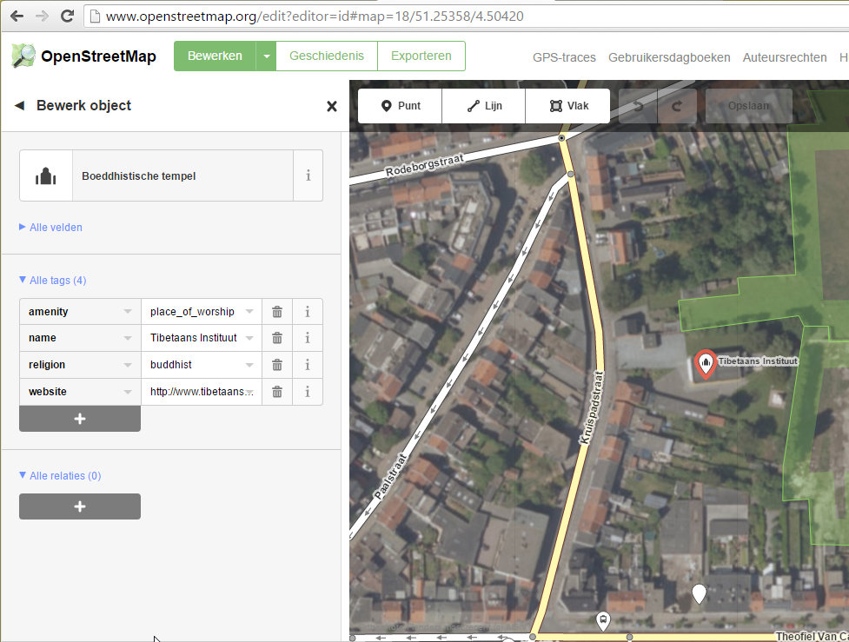
Notes:
-Open an ID editor, and add some local POIs in your neighborhood. Say, the local buddhist temple.

Slide 16
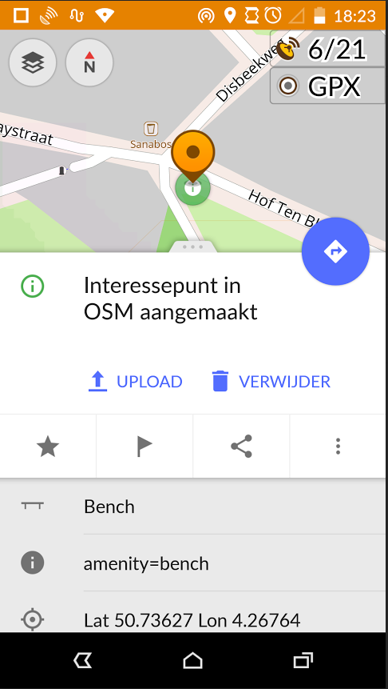
Notes:
-Install (nerdy) Osmand or (easy) Maps.me and add info for the places you visit. If it's easy, add the info yourself. if it's complicated, add a Note for someone else to fix.

Slide 17
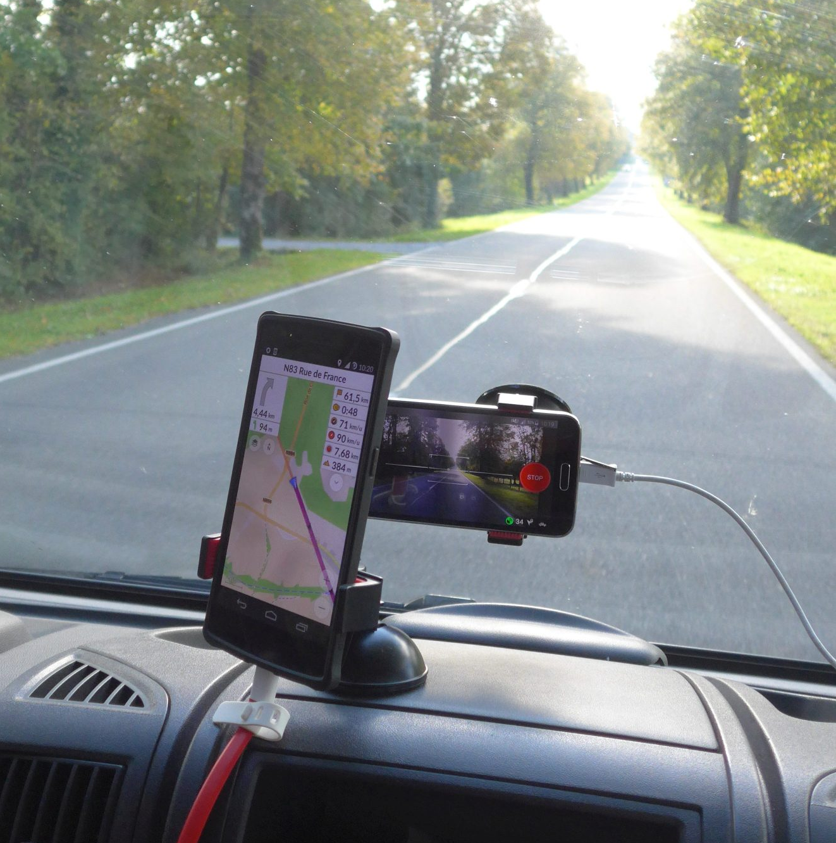

Step 1: install app
Step 2: take pictures
Step 3: upload pictures
Contribute to an open streetview of the world, one we can use for mapping
Notes:
-Or when you go hiking, biking or driving, take pictures of your route with Mapillary. You'll be contributing to an open streetview of the world, one which does not focus on places you can make money first, or almost only car oriented photgraphy.
And is it is open licenced, you can use this to map things like road quality, turn lanes, max speeds, speed bumps and POIs.
For the lazy, it looks like this.

Slide 18
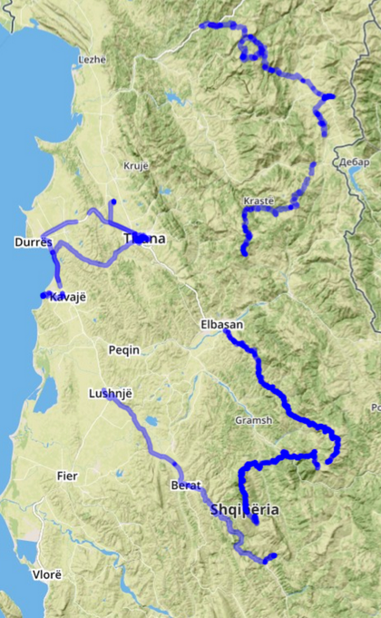
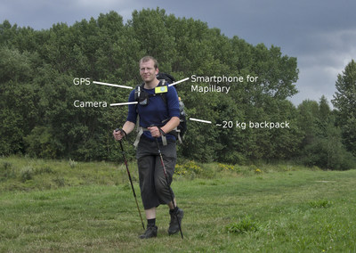
Notes:
But it can also look like this.

Slide 19
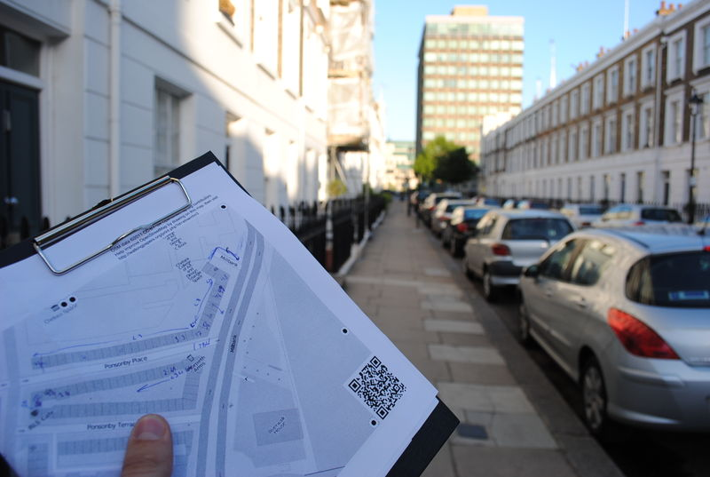
Walking Papers
Notes:
-Or print out an area of interest and hit the streets to collect info.

Slide 20
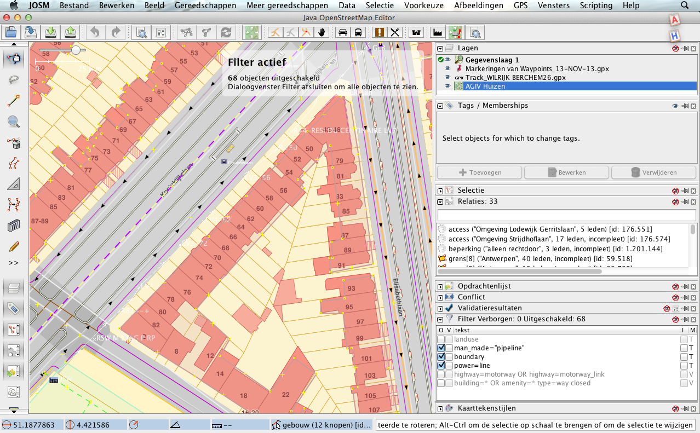
Notes:
And finally: find an open dataset and import it to OSM or use it to improve the map.

Slide 21
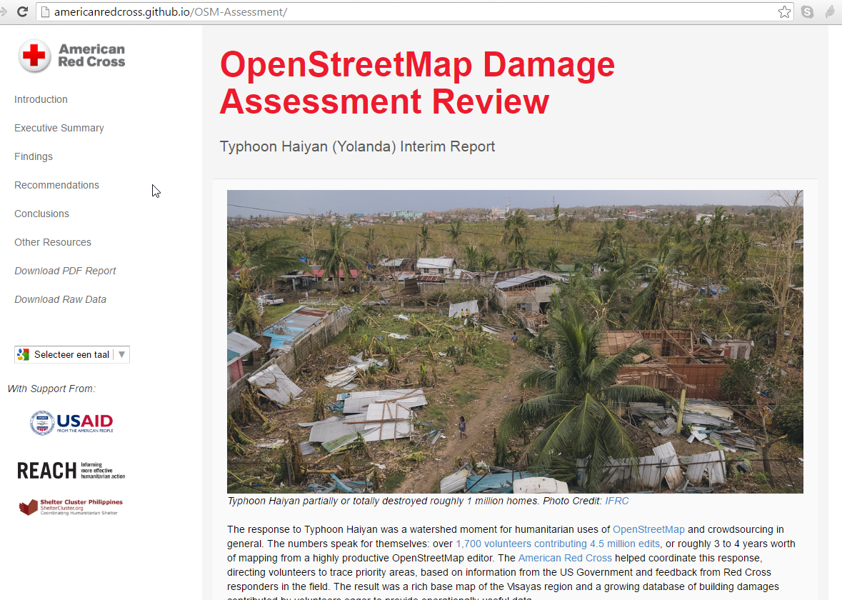
Notes:
Or better yet, why not just collect your data within OSM?

Slide 22
Links slideshare.com/joostschouppe
Evolution of OSM maps: http://www.openstreetmap.org/user/joost%20schouppe/diary/21826
Editing the map with Maps.me: http://maps.me/en/help#mapeditor
Overpass Turbo: http://overpass-turbo.eu/s/gE8
Your OSM heatmap: http://hdyc.neis-one.org/?joost%20schouppe
Map coloured by contributor
Historical OSM map: http://gk.historic.place/
Paved roads in OSM: http://www.openstreetmap.org/user/joost%20schouppe/diary/38103 and
http://www.openstreetmap.org/user/joost%20schouppe/diary/35883
Lazy Mapillary: http://www.openstreetmap.org/user/joost%20schouppe/diary/36196
Mapillary in Albania: http://blog.mapillary.com/update/2014/10/27/long-hike.html
Walking Papers: http://wiki.openstreetmap.org/wiki/Walking_Papers
Import guidelines: http://wiki.openstreetmap.org/wiki/Import/Guidelines
Typhon Haiyan Damage Assesment with OSM: http://americanredcross.github.io/OSM-Assessment/

